Slide 1
Chapter 6 - Network firewall IPS and Anti-virus configuration

Slide 2
IDS/IPS and its role in security
IDS
A device or software application that DETECTS and alert computer or network breaches.
Reporting tools to help administrators analyze the data interactively during & after the incident
Notes:
IDS – provides visibility (see what is happening)
IPS – provides control

Slide 3
IDS/IPS and its role in security
Types of breaches
Security policy violations: Systems or users who are running applications against policy
Infections: Viruses or Trojan horses that have partial or full control of internal systems, using them to spread infection and attack other systems
Information leakage : Running spyware and key loggers, as well as accidental information leakage by valid users

Slide 4
IDS/IPS and its role in security
Configuration errors: Applications or systems with incorrect security settings or performance-killing network misconfiguration, as well as misconfigured firewalls where the rule set does not match policy
Unauthorized clients and servers including network-threatening server applications : DHCP or DNS service, along with unauthorized applications such as network scanning tools or unsecured remote desktop.
Notes:
Network forensics, and analysis capabilities, the most important part of the picture is the IDS management console -quick and natural way to gain network and security visibility.
Without an effective way of extracting information from the IDS

Slide 5
IDS/IPS and its role in security
Key takeaways for IDS
Extended by IPS by adding the ability to block threats, which became the dominant deployment option.
A listen-only device.
Capable attackers which can exploit vulnerabilities very quickly often render IDS useless as a preventive measure.
Detection usually achieved by using copies of network traffic to reduce impact on network performance
Notes:
Not in the true real-time communication path between the sender and receiver of information

Slide 6
IDS/IPS and its role in security
IPS
A device that monitors network and/or system activities for malicious or unwanted behavior and react in real-time.
Works like a firewall but instead of finding reasons to let a packet pass through, it looks for reasons to BLOCK the packet into the network.
A proactive mechanism that has the ability to detect attacks as in IDS and prevent the attacks from being successful.
Notes:
IDS – provides visibility (see what is happening)
IPS – provides control

Slide 7
IDS/IPS and its role in security
IPS preventive actions
Dropping the malicious packets: Identified via known signatures or hashes. Two types: Exploit-facing and Vulnerability-facing
Blocking traffic from the source address: Deny traffic from known malicious URLs, domains
Notes:
Exploit-facing signatures identify individual exploits by triggering on the unique patterns of a particular exploit attempt. The IPS can identify specific exploits by finding a match with an exploit-facing signature in the traffic stream
Vulnerability-facing signatures are broader signatures that target the underlying vulnerability in the system that is being targeted. These signatures allow networks to be protected from variants of an exploit that may not have been directly observed in the wild, but also raise the risk of false-positives.

Slide 8
IDS/IPS and its role in security
Statistical anomaly detection: Takes samples of network traffic at random and compares them to a pre-calculated baseline performance level. When this sample falls outside the parameters of baseline performance, the IPS takes action to handle the situation.
Integration Capability: Commonly integrated into Unified Threat Management (UTM) solutions (for small and medium size companies) and next-generation firewalls (at the enterprise level).
Notes:
Exploit-facing signatures identify individual exploits by triggering on the unique patterns of a particular exploit attempt. The IPS can identify specific exploits by finding a match with an exploit-facing signature in the traffic stream
Vulnerability-facing signatures are broader signatures that target the underlying vulnerability in the system that is being targeted. These signatures allow networks to be protected from variants of an exploit that may not have been directly observed in the wild, but also raise the risk of false-positives.

Slide 9
IDS/IPS and its role in security
Key takeaways for IPS
Needs tuning to match network and application to avoid high rate of false positives.
Outstanding tool employed in defence-in-depth strategy to network security
Notes:
high rate of false positives, which can interrupt legitimate traffic, or you'll miss a lot of attacks
Must be efficient to avoid degrading network performance

Slide 10
IDS/IPS and its role in security
Needs to quickly detect and respond accurately, so as to eliminate threats and false positives (legitimate packets misread as threats) because exploits can happen in near real-time
Efficient enough not to hamper network performance
Notes:
high rate of false positives, which can interrupt legitimate traffic, or you'll miss a lot of attacks
Must be efficient to avoid degrading network performance

Slide 11
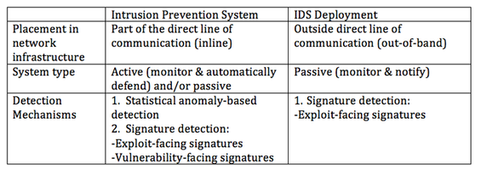
IDS rules, configuration
Notes:
Not in the true real-time communication path between the sender and receiver of information

Slide 12
IDS rules, configuration
Logical Layout
Critical
Files
Signature
Database
Network
Traffic
Traffic
Collector
Analysis
Engine
User
Interface
Log
Files
Alarm
Storage
Reports
Notes:
Any well-planned and well-tuned intrusion detection system will be an excellent addition to your defense-in-depth strategy.
A poorly planned and noisy IDS will just be a nuisance.

Slide 13
IDS rules, configuration
Location:
Network Perimeter (Just inside the firewall)
Helps understand attacks that originate outside your network.
Downside: Unable to cover exploits that originate from internal network
At core router/switch (or more locations) to examine packets traversing at both directions. More locations means more data to store, examine and act upon.
Notes:
Why not outside firewall?
unfiltered Internet activity is likely to fill up quickly
traffic that doesn't get through the firewall is of no interest

Slide 14
IDS rules, configuration
Other considerations:
Admin console (User Interface):
An interface for administration and control.
Should be on a separate, secure network.
Storage (includes Signature Library):
IDS log files can get huge.
Needs data on the history and genesis of a successful attack.
Notes:
Not wise to have log storage system filling up and copying over log files while you're under attack.

Slide 15
IDS rules, configuration
Host Based Set Up (HIDS)
Network Based Setup (NIDS)

Slide 16
IDS rules, configuration
Host Based Set Up (HIDS):
Looks at data given to it by the traffic collector and matches it
to known patterns of activity stored in the signature database.
Analysis: Remember how the current activity compares to
historic or future traffic, so that it may match more complicated, multi-step malicious activity patterns
Notes:
The longer it takes to match a malicious pattern, the less time the IDS or human operator has to react to malicious traffic.

Slide 17
IDS rules, configuration
Network Based Set Up (NIDS):
Critical
Files
Signature
Database
Network
Traffic
Traffic
Collector
Analysis
Engine
User
Interface
Log
Files
Alarm
Storage
Reports
Notes:
Behaves the same way as a network traffic sniffer.
Pulls every packet from the connected network.

Slide 18
IDS rules, configuration
Network Based Set Up (NIDS):
Concerned with bits and bytes traveling through cables
interconnecting the systems. Capable of collecting packets and examining them individually, or reassembles them into an entire
traffic session.
Analysis: Analyse traffic by protocol, type, amount, source,
destination, content, and traffic already seen.
Eg. Ping Flood – To remember and count the number of ping from a specific IP.
Notes:
The IDS must be able to handle traffic at whatever speed the network operates to be effective.

Slide 19
IDS rules, configuration
Network Based Set Up (NIDS):
Looks for activities that represent hostile actions or misuse
Denial-of-Service attacks
Port scans or sweeps
Malicious content in the data payload of a packet or packets
Vulnerability scanning
Trojans, viruses, or worms
Tunneling
Brute-force attacks
Notes:
Not wise to have log storage system filling up and copying over log files while you're under attack.

Slide 20
IDS rules, configuration
IDS Signatures:
Two main types: Content and Context

Slide 21
IDS rules, configuration
IDS Content Signatures:
Look at the content of network packets or log entries
Easy to build
eg. certain string of characters or a certain flag set in a TCP packet.
Matching the characters “/etc/passwd” in a telnet session
someone is trying to retrieve the UNIX password file.
Matching a TCP segment with the sync, reset and urgent flags all set combination of these flags is abnormal and indicates the segment is hand-crafted!
Notes:
For an content-based / atomic signature, a single packet, activity, or event is examined to determine if the signature should trigger a signature action. Because these signatures trigger on a single event, they do not require your intrusion system to maintain state. The entire inspection can be accomplished in an atomic operation that does not require any knowledge of past or future activities.

Slide 22
IDS rules, configuration
IDS Context Signatures:
Match large patterns of activity and examine how certain types of activities fit into the other activities going on around them.
Eg: “how does this event compare to other events that have already happened or might happen in the near future?”
Notes:
Context-based or stateful signatures trigger on a sequence of specific events that requires the IDS to maintain state.
Stateful signatures usually require several pieces of data to match an attack signature. The maximum amount of time over which an attack signature can successfully be detected (from the initial data piece to the final data piece needed to complete the attack signature) is known as the event horizon. The intrusion system must maintain state information for the duration of the event horizon. The length of event horizon varies from one signature to another. The important point to consider is that an IPS cannot maintain state information indefinitely without eventually running out of resources. Therefore, an IPS uses a configured event horizon to determine how long it looks for a specific attack signature once an initial signature component is detected.

Slide 23
IDS rules, configuration
Signatures Examples (Snort):
alert icmp $EXTERNAL_NET any -> $HOME_NET any
(msg:”ICMP PING NMAP”; dsize: 0; itype: 8;)
  Rule generates alert for ICMP having empty payload, ICMP type 8, and
  arriving from the outside.
  This is part of an NMAP ping.
alert tcp $EXTERNAL_NET any -> $HOME_NET 139
(msg: “DOS SMBdie attack”:; flags: A+; content:“57724c6568004577a|”;)
  Rule generates alert if a TCP packet from outside contains |57724c6568004577a| in payload and is headed to port 139 (netbios)
  for some internal host.
  This is part of a buffer overflow attack on a computer running Server Message Block Service.

Slide 24
IDS rules, configuration
Signatures Examples (Snort):
alert tcp $EXTERNAL_NET any -> $HTTP_SERVERS $HTTP_PORTS
(msg:”WEB-IIS ISAPI .ida attempt”; uricontent:”.ida?”;
nocase; dsize:>239; flags:A+;)
  Rule generates alert for packet heading to Web server with .ida? in URL in GET message
  Buffer overflow attack that allows attacker to take over server.

Slide 25
IDS rules, configuration
Signatures Examples (Snort Rule Set):

Slide 26
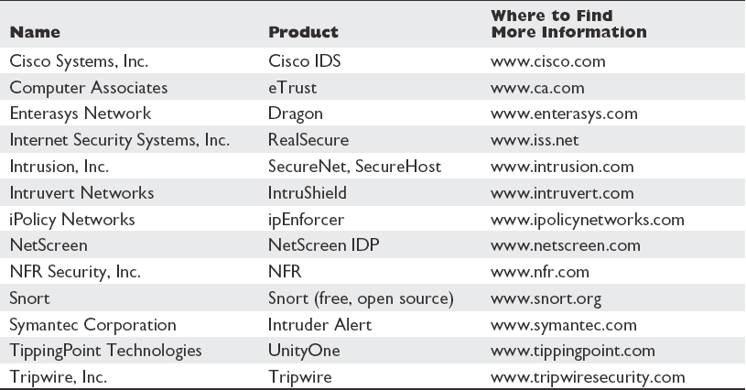
IDS rules, configuration
Notes:
Popular IDS products and vendors

Slide 27
IDS rules, configuration
IDS Context Signatures:
Eg: Matching a ping flood attack
A single ICMP packet on its own is generally regarded as harmless
Thousands of ICMP packets coming from a single system in a short
period of time can cause a DOS
IDS must be able to count number of ICMP packets received from
same source by various machines.
Notes:
Disadvantages:
Consumes more resources, can lead to a slow response time, dropped packets, missed signatures
Example:
Windows command shell, cmd.exe can be invoke remotely by attackers. To remotely execute cmd.exe, the attacker must make a network connection to the host. This information can be used to refine by adding state. The stateful signature triggers a signature action when cmd.exe is invoked, but only if the application invoking cmd.exe first accepted a network connection.
For example, attacks against a web server often occur in the URL request. The sensor starts looking for buffer overflow signatures after the client sends the HTTP request. The Cisco sensor must be aware of the flow and parameters of each traffic type being searched for context-based signatures.

Slide 28
IDS rules, configuration
IDS is not foolproof!
There is no way for an IDS to know the true intent behind an activity and determine whether or not it is benign or hostile.
Therefore, the IDS can react only as it has been programmed.
Need to take false positives and false negatives into
consideration.
Notes:
Needs considerable amount of Security experts analysis

Slide 29
IDS rules, configuration
False Positives
When an IDS matches a pattern and generates an alarm for benign traffic, meaning the traffic was not hostile and not a threat,
this is called a false positive.
False Negatives
Hostile activity that does not match an IDS signature and,
therefore, goes undetected is called a false negative.

Slide 30
IPS rules, configuration
IPS can do more – BLOCK malicious traffic
Typical IPS Setup is to block two types of malicious traffic:
Exploit and Anomaly

Slide 31
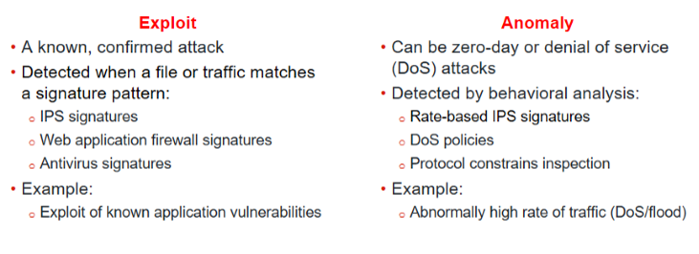
IPS rules, configuration
Notes:
Exploits are known attacks, with known patterns that can be matched by IPS, web application firewall, or antivirus signatures.
Anomalies are unusual behaviors in the network, such as higher-than-usual CPU usage or network traffic. Anomalies must be detected and monitored (and, in some cases, blocked or mitigated) because they can be the symptoms of a new, never-seen-before attack. Anomalies are usually better detected by behavioral analysis, such as rate-based IPS signatures, DoS policies, and protocol constrains inspection.

Slide 32
IPS rules, configuration
IPS can be configured with Flow-based (real traffic), or Proxy-based (copy of traffic – more time to analyze).
Both consist of:
IPS Engine
IPS Signatures
Notes:
Signatures similar to IDS signatures

Slide 33
IPS rules, configuration
1. IPS Engine (handles both Exploit and Anomalies)
Protocol decoders – used to determine packet has anomaly or exploit
Application control (Block Peer to Peer traffic)
Flow-based antivirus protection (prevent clients from downloading spywares, worms)
Web filtering (blocks requests based on category of web server pages)
Email filtering
Data Leakage Prevention.
Notes:
Signatures similar to IDS signatures
Web filtering – Fortiguard
Application control
Not all URL requests to www.youtube.com are for video. Your browser makes several HTTPS requests for:
the web page itself
images
scripts and style sheets
Video
If an application is necessary, but you need to prevent it from impacting bandwidth, then instead of blocking it entirely, you can apply a rate limit to the application. For example, you can rate limit applications used for storage or backup leaving enough bandwidth for more sensitive streaming applications, such as video conferencing.
All of these items have separate URLs. If you analyze a site like YouTube, the web pages themselves don’t use much bandwidth; it is the video content that uses the most bandwidth. But, since all content is transported using the same protocol (HTTPS), and the URLs contain dynamically generated alphanumeric strings, traditional firewall policies can't block or throttle the traffic by port number or protocol, because they are the same. Using application control, you can rate limit only videos. Doing this prevents users from saturating your network bandwidth while still allowing them to access the other content on the site, such as for comments or sharing links.

Slide 34
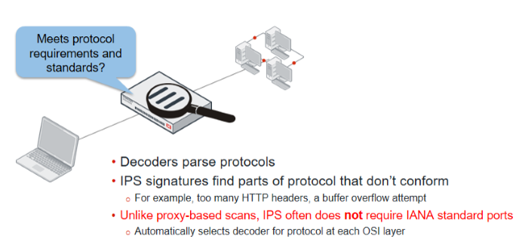
IPS rules, configuration
IPS Engine – Protocol Decoders

Slide 35
IPS rules, configuration
2a IPS Signatures – Preventing Exploits
Signature database contains signatures for common attacks whose signatures cause rare or no false positives.
It's a smaller database, and its default action is to block the detected attack.
Notes:
Extended Signature can contain WAF signatures

Slide 36
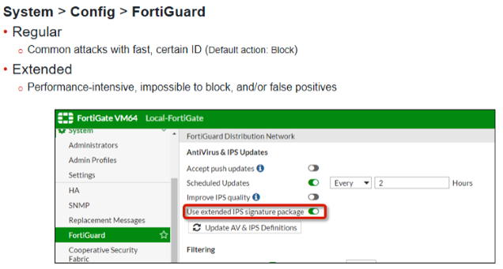
IPS rules, configuration
Exploits – Intrusion Prevention using signatures
Notes:
Signatures similar to IDS signatures

Slide 37
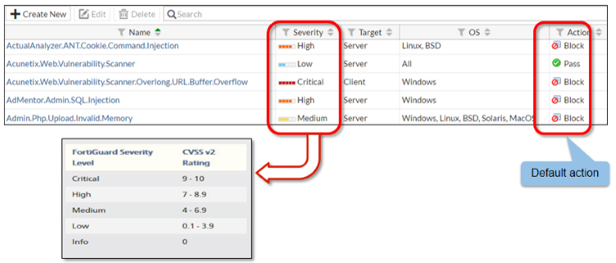
IPS rules, configuration
Exploits – Intrusion Prevention using signatures
Setting severity levels example
Notes:
Signatures similar to IDS signatures

Slide 38
IPS rules, configuration
Exploits – Intrusion Prevention using signatures
Writing Custom Signatures
Use packet capture to record packet samples. This is to help you understand and avoid mismatches with normal packets on your network.
Notes:
does not provide support for problems created by misconfigured custom signatures. So, if possible, you should test your custom signatures in a lab.

Slide 39
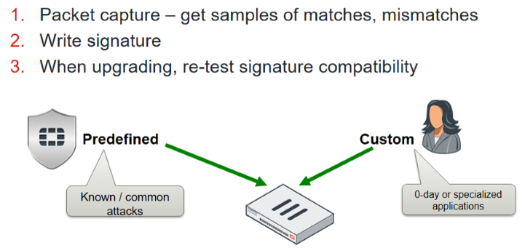
IPS rules, configuration
Exploits – Intrusion Prevention using signatures
Writing Custom Signatures
Notes:
does not provide support for problems created by misconfigured custom signatures. So, if possible, you should test your custom signatures in a lab.

Slide 40
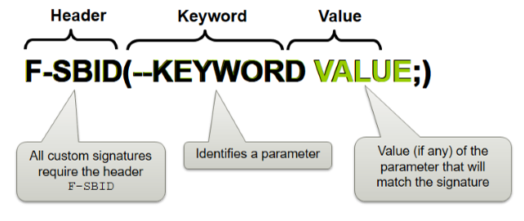
IPS rules, configuration
Exploits – Intrusion Prevention using signatures
Custom Signatures Syntax – Eg Fortinet
Notes:
Custom signature is product specific

Slide 41
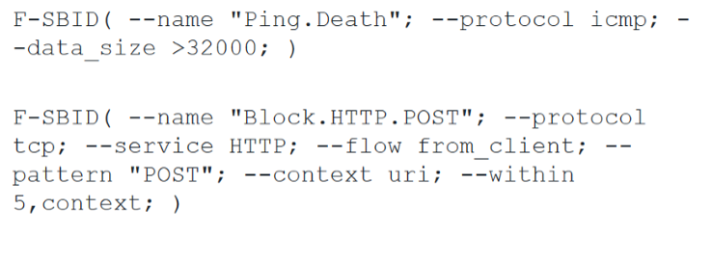
IPS rules, configuration
Exploits – Intrusion Prevention using signatures
Custom Signatures Syntax – Eg Fortigate
Notes:
In this example, the first sample custom signature is called Ping.Death. It searches for ICMP traffic that exceeds about 32 KB.
The next sample custom signature is called Block.HTTP.POST. It searches for the pattern POST in a specific location inside the packet. In normal HTTP POST requests, the method should be in this specific location. Using a specific location in the signature prevents IPS from scanning the entire HTTP payload, which could contain a web page that accidentally matches the pattern (for example, the words POSTAL CODE). Your signature should be specific, but not too specific – extra comparisons reduce performance.

Slide 42
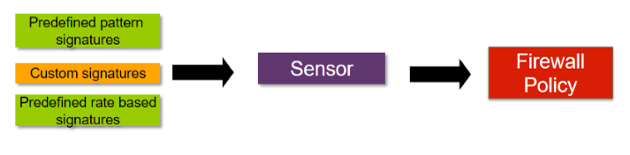
IPS rules, configuration
Exploits – Intrusion Prevention using signature
How to use the custom signatures?
Typically pair it with an action within an IPS sensor, then reference that IPS sensor in a firewall policy.
Notes:
. A single IPS sensor can combine multiple predefined and custom signatures.

Slide 43
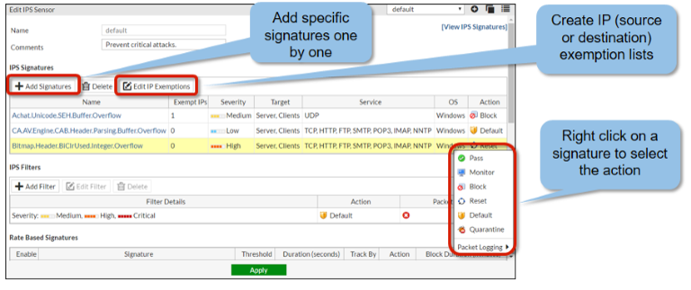
IPS rules, configuration
Exploits – Intrusion Prevention using signature
Adding predefined signatures to an IPS sensor –Method 1
Notes:
select the signatures individually
you can create an exemption list based on the source or destination IP address. Once a signature has been selected from the list, it is added to the sensor with its default action. After that, you can right-click the signature and change the action

Slide 44
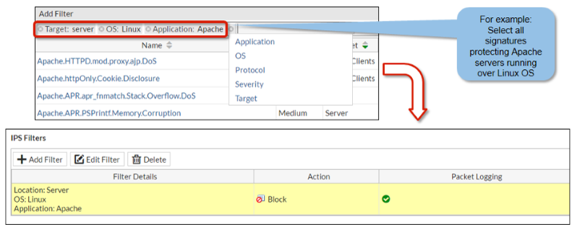
IPS rules, configuration
Exploits – Intrusion Prevention using signature
Adding predefined signatures to an IPS sensor –Method 2
Notes:
Using filters. Add all the signatures that match the filters.
Create a filter to include all the signatures that protect Apache severs running over a Linux OS. The action is set to block all traffic that matches those signatures.
Each individual signature can include multiple tags, such as HTTP, Microsoft, IIS, and TCP. The more specific you can make your filter, the less resources will be used to scan your traffic. This is because the signature’s parts will seldom match the traffic, so the IPS engine can quickly continue with the next comparison or scan.
If the signature that matches the traffic is both in the IPS Signature list and the IPS Filter list, the FortiGate applies the action specified in the former one.

Slide 45
IPS rules, configuration
2b Rate-based signatures (Anomalies)
Block specific traffic when one of the thresholds is exceeded during the configured time period (Duration).
Rate based signatures should be applied only to protocols you actually use. Then block malicious clients for extended periods.
Notes:
DoS attacks exhaust limited server-side bandwidth or sockets.
The goal of a DoS attack is to overwhelm the target – to consume resources until the target can’t respond to legitimate traffic.
This saves system resources and can discourage a repeat attack
eg FortiGate will not track statistics for that client while it is temporarily blacklisted.

Slide 46
IPS rules, configuration
Anomalies – Preventing DoS attack
4 protocols: TCP, UDP, ICMP and SCTP for anomaly detection.
Initially configure the DoS policy to log, but not block. Using the logs, analyse and determine normal and peak levels for each protocol. Then, adjust the thresholds to comfortably, but not loosely, allow the usual peaks.
Thresholds that are too high can allow your resources to be exhausted before the DoS policies trigger. Thresholds that are too low will cause IPS to drop normal traffic.
Notes:
A flood sensor detects a high volume of that particular protocol, or signal in the protocol.
A sweep/scan detects attempts to map which of a host’s ports respond and therefore may be vulnerable.
Source signatures look for large volumes of traffic originating from a single IP.
Destination signatures look for large volumes of traffic destined for a single IP.
All four protocols in the DoS profile (ICMP, TCP, UDP, SCTP) have an anomaly sensor for the source. These are built to examine the traffic that each IP is generating and compare that traffic to the threshold value.

Slide 47
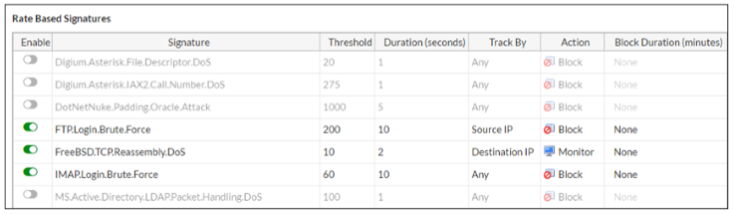
IPS rules, configuration
Anomalies – Preventing DoS attack
Rate-based signatures
Notes:
This saves system resources and can discourage a repeat attack
eg FortiGate will not track statistics for that client while it is temporarily blacklisted.

Slide 48
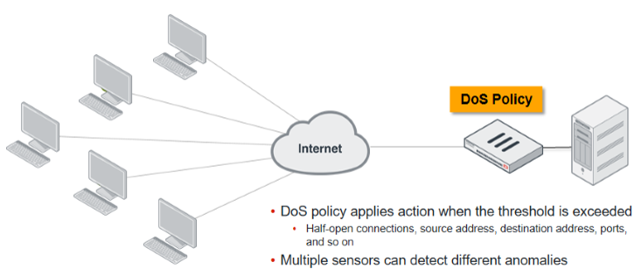
IPS rules, configuration
Anomalies – Preventing DoS attack
To block DoS attacks, apply a DoS policy on a IPS that sits between attackers and all the resources that you want to protect.
Notes:
Unless you know what bandwidth is abnormal for your network, you may not be able to confirm an attack

Slide 49
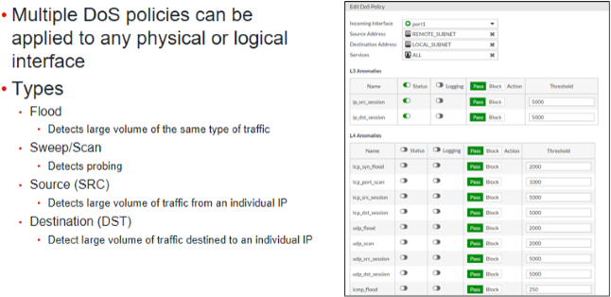
IPS rules, configuration
Anomalies – Preventing DoS attack
Notes:
Unless you know what bandwidth is abnormal for your network, you may not be able to confirm an attack

Slide 50
IPS rules, configuration
Can IPS do what the IDS can do?
Answer: One-arm sniffer deployment
Using Mirror/SPAN port forwards packets to IPS
IPS scans a copy
Does not block/intervene (Non disruptive)
Records log of the action the IPS would have taken in normal mode.
Notes:
Also called the sniffer mode
deploy IPS outside of the direct path of packets, in a one-arm topology with a monitor-only mechanism
The switch will send a duplicate of egressing packets to IPS for inspection. Notice that because IPS is inspecting a copy – not the original packet – it can’t modify or block the connection.
Historically, when IPS scanning was first invented, it was slow. Old IPS could introduce high latency. So, one-arm deployment was common, but IPS on an inline firewall wasn’t.
Now, hardware performance is much better, and one-arm sniffer has a significant limitation: cannot block traffic.

Slide 51
IPS rules, configuration
Typical IPS Setup
How about Zero-day attacks?
Notes:
Exploits of unknown vulnerabilities – called zero-day attacks – are sold for large amounts of money on the black market. Since these exploits aren’t known to their vendors, or to security experts, there’s no available patch or signature for detection. That’s what makes them so dangerous.
Some companies and organizations, like Facebook and Google, have offered bounties for the responsible disclosure of these exploits, but there’s a very profitable market for black hat hackers to sell these discoveries to everyone from covert government surveillance to organized crime syndicates.

Slide 52
IPS rules, configuration
Typical IPS Setup
You can prevent Zero-day attacks.
-Study your network’s baseline of normal behaviour
-Monitor unusual traffic volumes and patterns
-Firewall policies must allow only the connections required
-Prevent buffer overflows, cross-site scripting and so on.
Notes:
If you detect a zero-day attack, your initial instinct may be to take the server offline immediately, then format it to remove all traces of malware. But by doing this, you’ll alert the attacker, and destroy forensic evidence. This will only educate motivated attackers – their next attack will be harder to detect, and more sophisticated. Make sure your PSIRT(product security incidence response team) team understands the most appropriate way to respond to each different type of intrusion.

Slide 53
Cyber Intelligence from Logs
When traffic passes through your network, IPS/IDS scans the traffic and then takes action based on the policies in place. This activity is recorded and the information is contained in a log message. The log message is stored in a log file that is then stored on a device capable of storing logs
Logs provide you intelligence and with a greater perspective of your network, allowing you to make adjustments to your network security.
Notes:
The purpose of logs is to help you monitor your network traffic, locate problems, establish baselines, and more. Logs provide you with a greater perspective of your network, allowing you to make adjustments to your network security, if necessary.

Slide 54
Cyber Intelligence from Logs
Describing log types and subtypes
Describing log severity levels
Message log layout
Viewing logs
Monitoring your network
Reporting

Slide 55
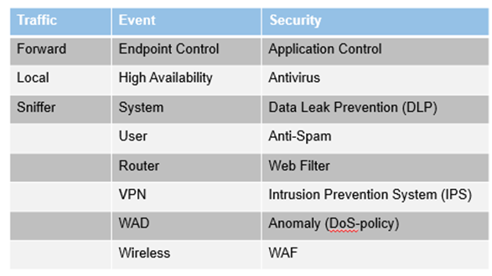
Cyber Intelligence from Logs
Log Types and Sub Types
Notes:
Traffic logs record traffic flow information, such as an HTTP/HTTPS request and its response, if any. It contains subtypes named forward, local, and sniffer.
Forward traffic logs contain information about traffic that FortiGate either accepted or rejected according to a firewall policy.
Local traffic logs contain information about traffic directly to and from the FortiGate’s management IP addresses. They also include connections to the GUI and FortiGuard queries.
Sniffer logs contain information related to packet capture.
Event logs record system and administrative events, such as adding or modifying configuration, or daemon activities. It contains subtypes named endpoint control, high availability, system, user, router, VPN, WAD, and wireless.
System event logs contain information related to operations, such as automatic FortiGuard updates and GUI logins.
User logs contain logon and logoff events for firewall policies with user authentication.
Router, VPN, WAD, and wireless subtypes include logs for those features. For example, VPN contains IPsec and SSL VPN log entries.
Finally, security logs record logs for the security events such as virus attacks and intrusion attempts. They contain log entries based on the security profile type (log type = utm), including Application Control, Antivirus, DLP, Anti-Spam (Email Filter), Web Filter, Intrusion Protection, Anomaly (DoS-policy), and WAF. Security logs and subtypes are only visible in the GUI menu if logs are created within it—if no security logs exists, the log menu item does not appear.

Slide 56
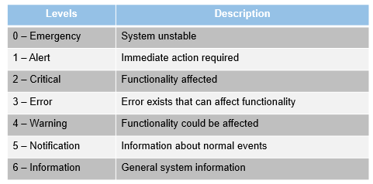
Cyber Intelligence from Logs
Log Security Levels
Notes:
Each log entry includes a log level (or priority level) that ranges in order of importance from emergency to information.
There is also a debug level, the lowest level. It puts diagnostic information into the event log. The debug level is rarely used, unless you are actively investigating an issue with Fortinet Technical Support. Generally, the lowest level you want to use is information, but even this level generates many logs and could cause premature hard disk failure. Depending on the type of log and the needs of your organization, you may want to log only notification levels or higher.
You and your organization’s policies dictate what must be logged.

Slide 57
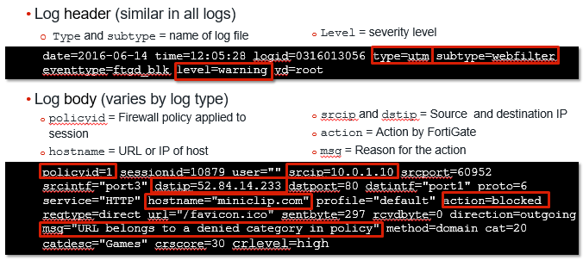
Cyber Intelligence from Logs
Log Message Layout
Notes:
Every log message has a standard layout comprised of two sections: a header and a body.
The header contains fields that are common to all log types, such as originating date and time, log identifier, log category, severity level, and virtual domain (VDOM). The value of each field, however, is specific to the log message. As you can see in the raw log entry example, the log type is UTM, the subtype is webfilter, and the level is warning. The type and subtype of logs determine what fields appear in the log body.
The body, therefore, describes the reason why the log was created and actions taken by FortiGate. These fields vary by log type. In the above example, the policyid field indicates which firewall rule matched the traffic, the scrip field indicates the source IP address, the dstip field indicates the destination IP address, the hostname indicates the URL or IP of the host, the action field indicates what FortiGate did when it found a policy that matched the traffic, and the msg fields indicates the reason for the action taken. In this example, the action is blocked, which means that FortiGate prevented this IP packet from passing, and the reason is because it belonged to a denied category in the firewall policy.
If you log to a third-party device, such as a syslog server, knowing the log structure is crucial to integration. For information on log structures and associated meanings, visit http://docs.fortinet.com.

Slide 58
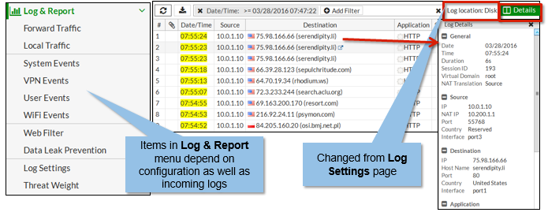
Cyber Intelligence from Logs
View Log Message
Notes:
You can view your logs in the GUI under the Log & Report menu. The options that appear in this menu depend on your configuration. Security logs appear only if security events exist.
Select the type of log you want to view, such as Forward Traffic. Logs then appear in a formatted table view. To view the log details, select the log from the table. The log details then appear in the Log Details pane to the right.
If archiving is enabled on security profiles that support it (such as DLP), archiving information appears within the Log Details pane under the Archived Data section. Archived logs are also recorded when using FortiAnalyzer or FortiCloud.
If you configured FortiGate to log to multiple locations and want to view logs from those locations, you must specify the location from the Log Settings page. In this screenshot, the log location is set to Disk, as that is the configured setting on the Log Settings page. If logging to a remote location, such as Syslog, you must view logs through that device instead.

Slide 59
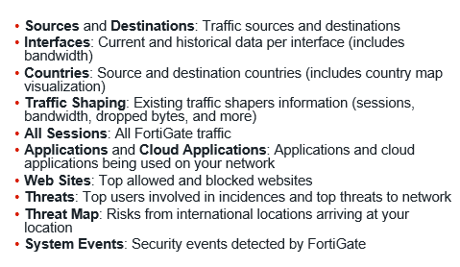
Cyber Intelligence from Logs
Log Monitoring Options (Fortigate)
Notes:
Some of the areas you can monitor under the FortiView menu include:
Sources: Allows you to view information about the sources of traffic on your FortiGate. You can use this to investigate a spike in traffic, for example.
Interfaces: Allows you to perform current and historical monitoring by interface, with the ability to monitor bandwidth, in particular. You can use this to investigate traffic spikes associated with an IP address, for example.
Countries: Allows you to filter traffic according to source and destination countries. This includes the option to view the country map visualization. You can use this to investigate international source bandwidth usage for specific sources, for example.
All Sessions: Allows you to view information about all FortiGate traffic. This console has the greatest number of column filter options. You can use this to filter sessions by port number and application type, for example.
Applications: Allows you to view information about the applications being used on your network.
Cloud Applications: Allows you to view information about the cloud-based applications being used on your network.
Web Sites: Allows you to view information about the top allowed and top blocked websites by domain or FortiGuard categories. You can use this to investigate an instance of proxy avoidance, for example.
Threats: Allows you to view information about the top users involved in incidences as well as the top threats in your network.
Threat Map: Allows you to view risks coming from various international locations arriving at your location, displayed through a map. You can use this to investigate various international threats.

Slide 60
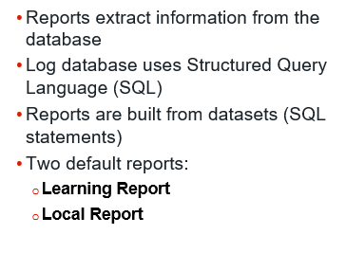
Cyber Intelligence from Logs
Reporting

Slide 61
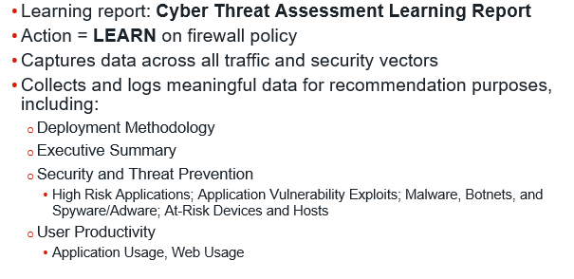
Cyber Intelligence from Logs
Reporting – Learning Report
Notes:
In Fortinet,
When learning mode is enabled on a firewall policy, data across all traffic and security vectors is captured and generated in the Cyber Threat Assessment Learning Report. The purpose of this report is to allow users to easily implement a monitor then enforce process.
Data includes:
Deployment methodology
Executive summary
Security and threat prevention, which includes high risk applications; application vulnerability exploits; malware, botnets, and spyware/adware; and at-risk devices and hosts
User productivity, which includes application usage and web usage

Slide 62
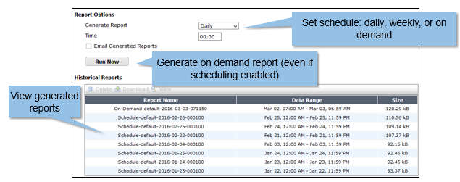
Cyber Intelligence from Logs
Reporting – Local Report
Notes:
You can configure report options, run reports on demand, and view reports from the Local Reports page.
Report options include specifying a schedule to run a report (for example, daily or weekly at a specific time of day), and specifying whether to email the generated reports. If you do not want to schedule reports, you can choose to generate on demand instead. You can run on demand reports even if scheduling is enabled by clicking Run Now.
You can view all generated reports from the Historical Reports table.

